Slide 1
The D igital S cholarship L aboratory
Evans Library
Florida Institute of Technology

Slide 2
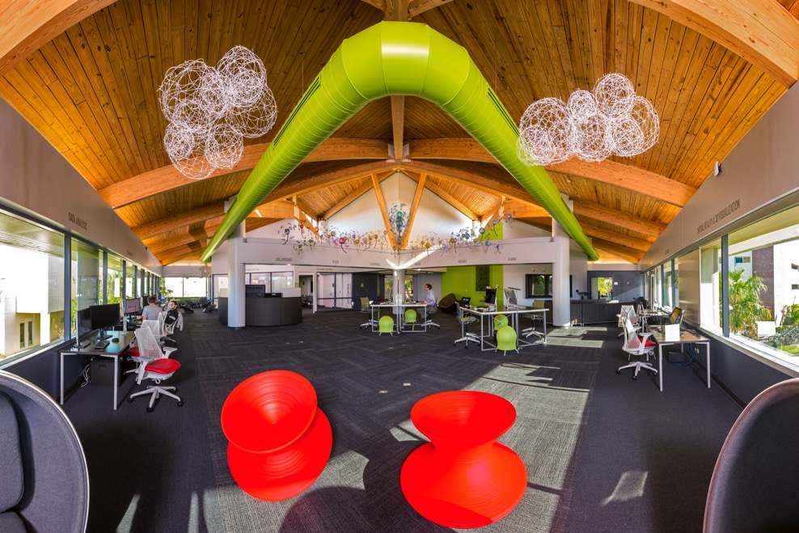
Digital Scholarship Laboratory (DSL)
The DSL is a state-of-the-art lab that supports digital scholarship, e-research & cross-disciplinary collaboration for breakthrough innovation.

Slide 3
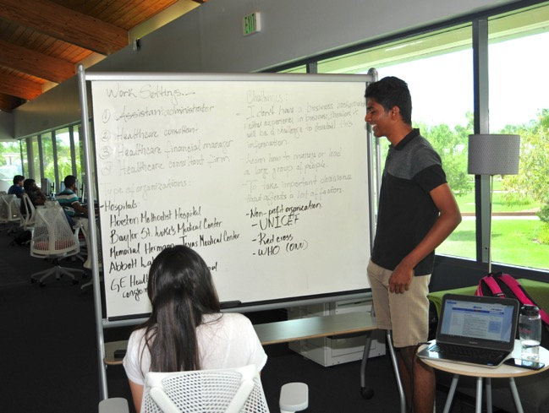
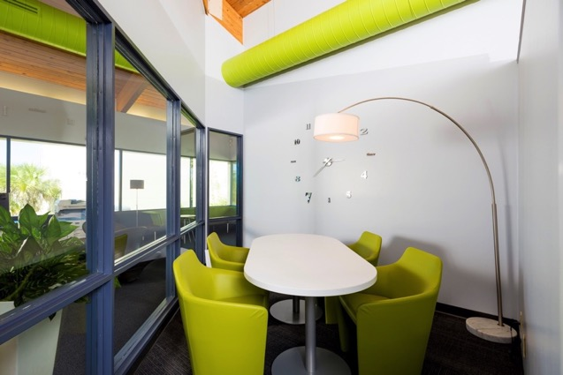
Why Do We Need a DSL?
To allow students to access, explore, integrate and share current and future research across all disciplines;
To make resources more transparent in a dedicated space that fosters sharing & collaboration;

Slide 4
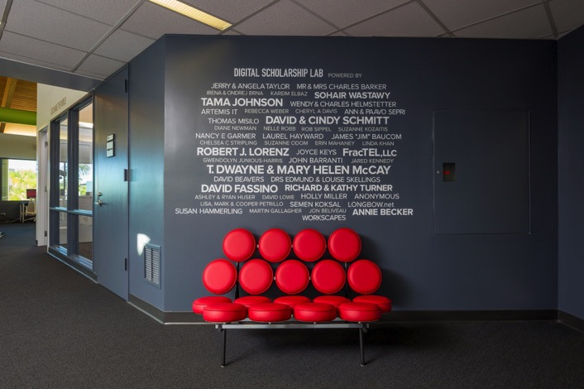
Why Do We Need a DSL?
To be a springboard of innovation for Florida Tech students;
To offer specialized services & spaces where faculty & students can work on research projects; and
To offer sophisticated technologies coupled with expert assistance of highly-trained staff in IT & data science.

Slide 5
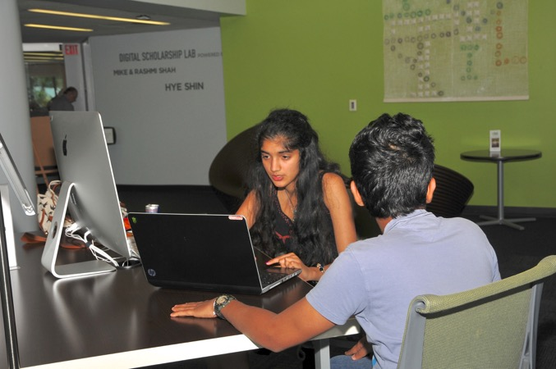
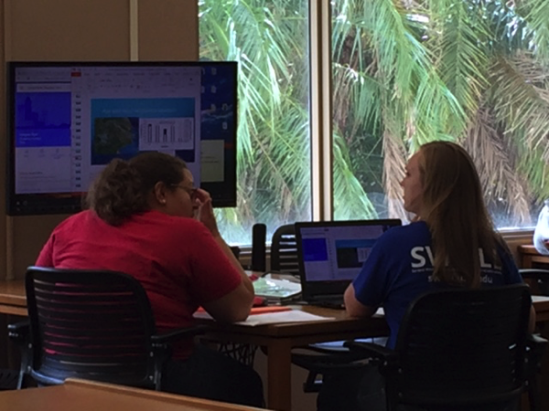
DSL: Collaboration
The DSL is a smart space that enables hands-on training and informal presentations in a collaborative enabled environment.

Slide 6
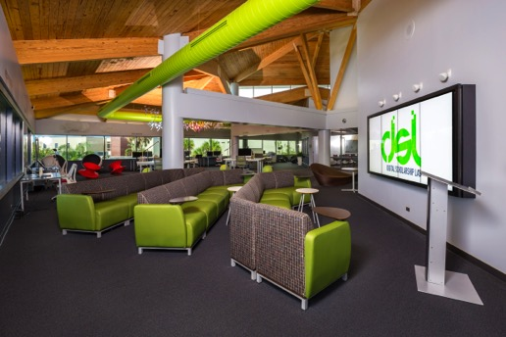
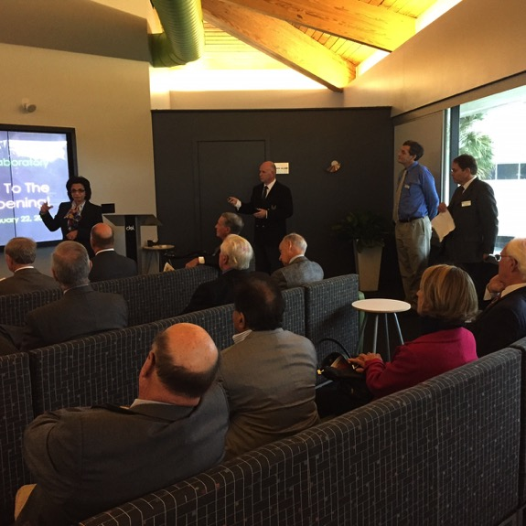
DSL: Presentation
The 10’ x 4’ video wall is a large interactive touch screen with an audio system that facilitates crisp, vivid presentations in a theater-like area.

Slide 7
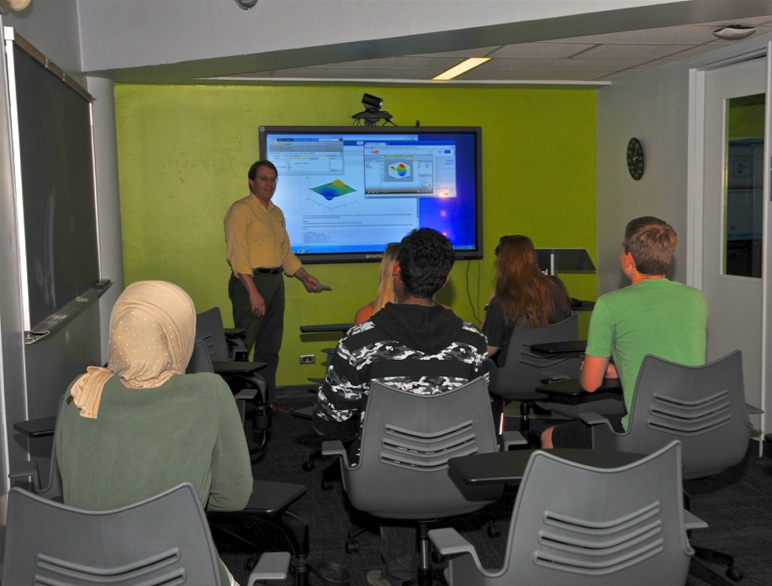
DSL: Interactivity
The classroom has an interactive 70” screen, running both Windows & Android.
It empowers team-based activities, presentations, video teleconferencing and active learning.

Slide 8
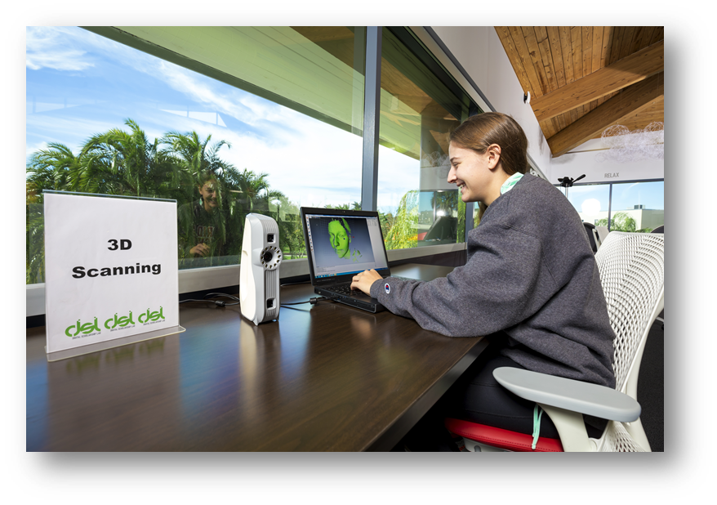
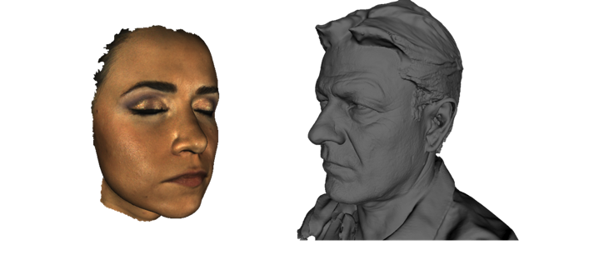
DSL: Visualization
The 3D scanner makes quick, textured & accurate models of medium-sized objects, such as a human face and scans quickly in high resolution & vibrant colors.

Slide 9
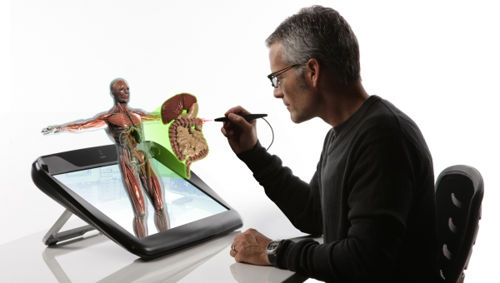
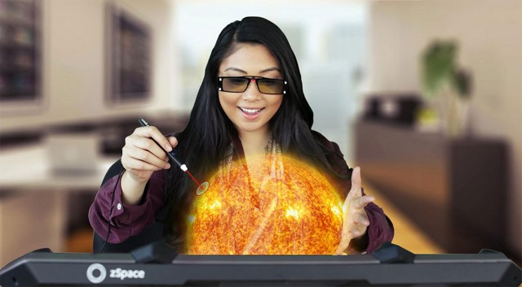
DSL: 3D Visualization
The zSpace desktop virtual reality workstation enables interactive viewing of models in 3D. Popular with disciplines from anatomy to mechanical engineering, its potential to enhance learning is vast.

Slide 10
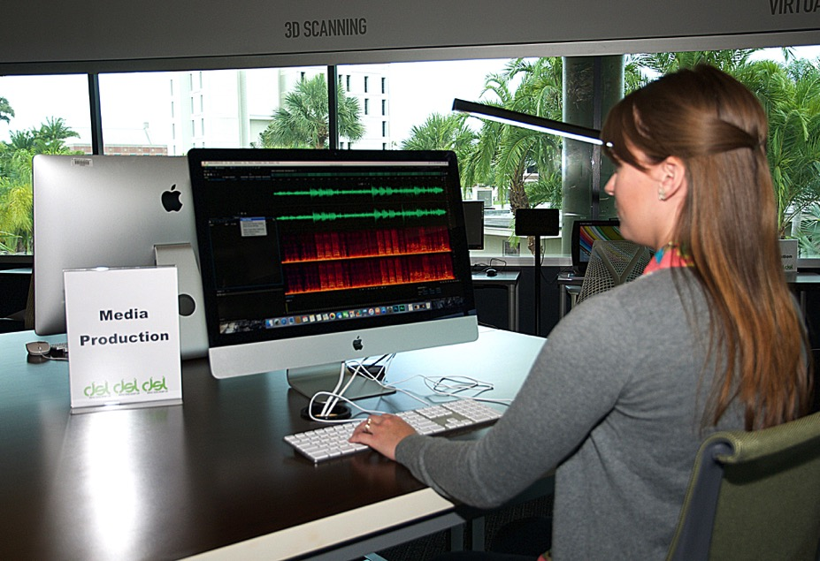
DSL: Media Production
The Lab features powerful tools for creating professional presentations & multi-media productions, including: photographic, audio, animation & video editing.

Slide 11
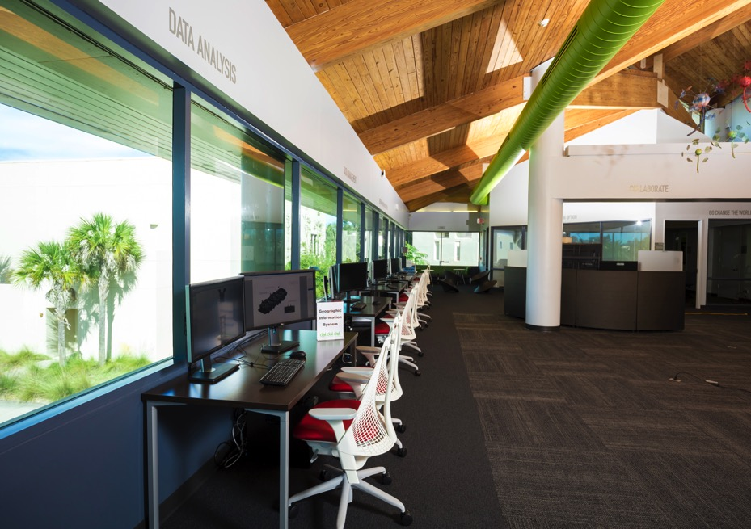
DSL: Geospatial Thinking
High performance, GIS dual-monitors produce fully detailed maps layered with current & historical data for cross-disciplinary geospatial projects.
Also available: 3D modeling & mathematical calculation & simulation software.

Slide 12
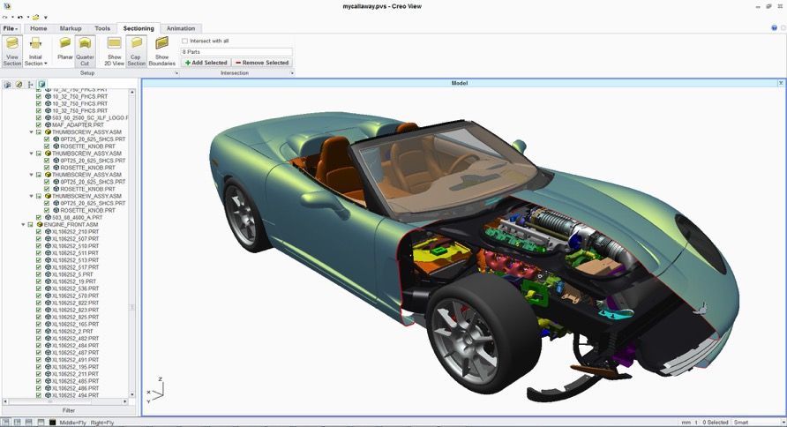
DSL: Modeling
Powerful graphics engines & 3D modeling software create fast simulations. Models created virtually can be turned into real world prototypes in the 3D printing lab.

Slide 13
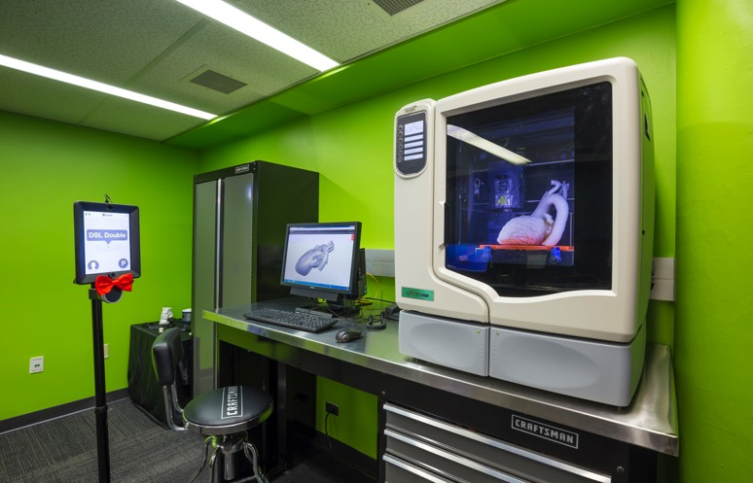
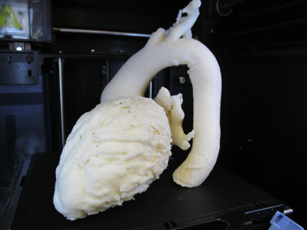
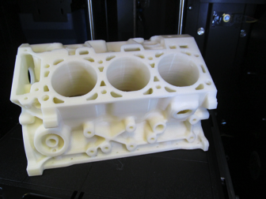
DSL: 3D Printing
The 3D printing Lab turns visualized ideas into usable products.
3D printers have become essential tools in university student projects, as they provide a low-cost solution to prototyping & development.

Slide 14
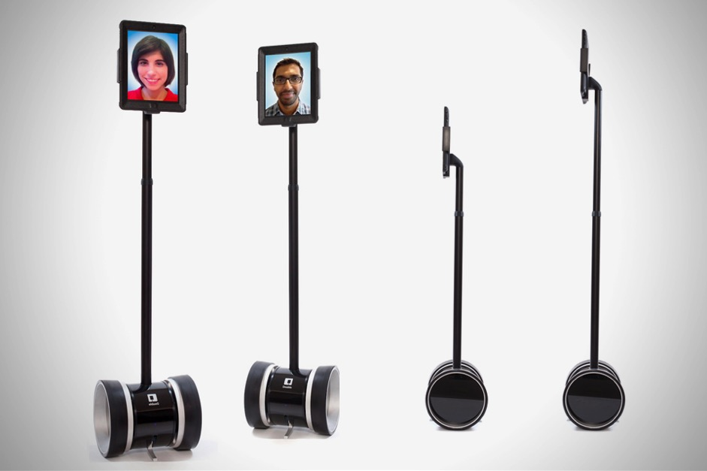
DSL: Communication
The tele-presence robot allows a user to participate virtually with the addition of mobility, providing a more life-like experience for remote participation in DSL activities.

Slide 15
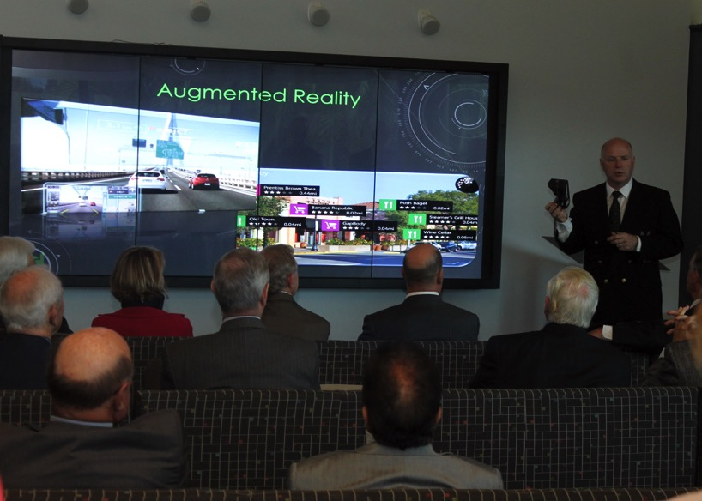
DSL: Training
Workshops are taught to faculty and students on topics such as GIS, data visualization, research data management and 3D modeling using software including SolidWorks, Creo, Tableau and Matlab.

Slide 16
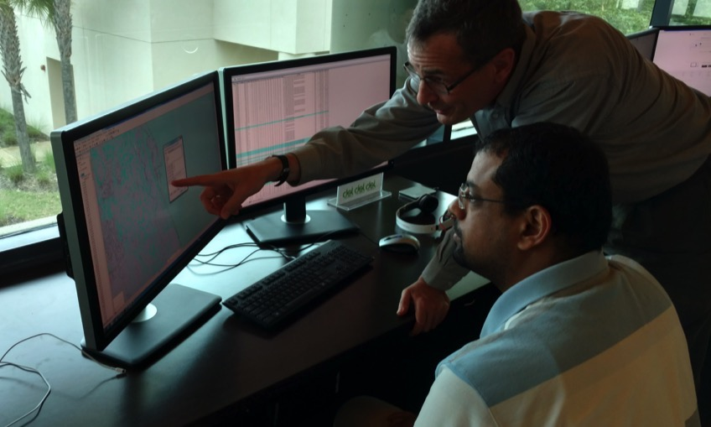
DSL: Consulting
DSL staff assist students and faculty throughout the lifecycle of their research projects, grant applications and learning.

Slide 17
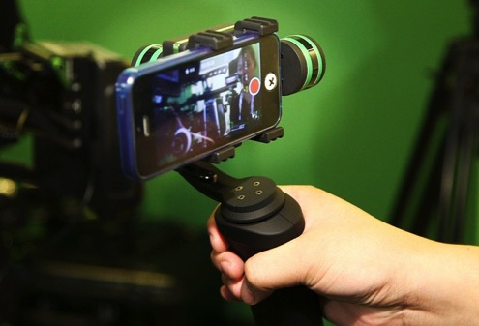
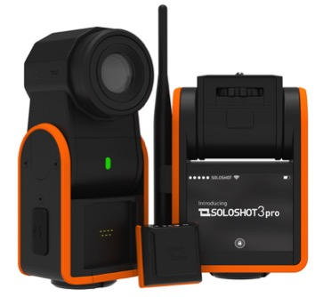
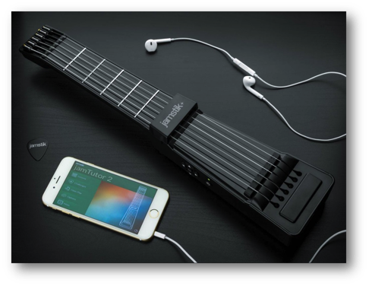
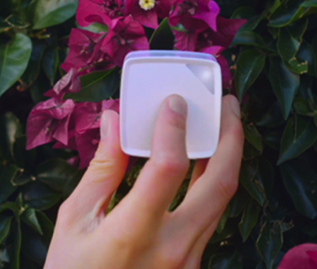
DSL: Technology Lending
A variety of cool gadgets & innovative devices are available to engage students in exploration & active learning.
Camera Gimbal
Soloshot 3 Video
Jamstik Midi Guitar
CUBE Color Sampler

Slide 18
T he N ext G en L ibrary!

